Slide 1
WP4: Progress Update
Objective: Main development inverter for high voltage system.
 | 2023 |  |  |  | 2024 |  |  |  | 2025 |  |  |  | 2026
4.1 Inverter topology and construction |  |  | x | x | x | x | x | x | x
4.2 Intelligent gate driver |  |  |  |  |  |  | x | x | x | x | x | x | x
4.3 Cooling of DC link capacitors |  |  |  |  |  |  |  | x | x | x | x
4.4 High bandwidth current meas. |  |  |  |  |  |  |  |  |  |  | x | x | x | x
4.1: The high-voltage inverter can be designed as a two-level, three-level, or multi-level inverter, requiring theoretical evaluation and comparison of various topologies and modular configurations to optimize efficiency, compactness, and cost.
4.2: The gate driver controls the inverter’s semiconductor components and can optimize motor stresses and perform state estimation by monitoring parameters like gate threshold voltage and leakage current, requiring comparison of different designs for performance and reliability.
4.3: DC link capacitors’ size and reliability depend heavily on temperature, making it essential to evaluate various cooling methods, both theoretically and experimentally.
4.4: Current measurement methods need evaluation, as higher bandwidth offers advantages like improved state estimation of the motor's stator winding.

Slide 2
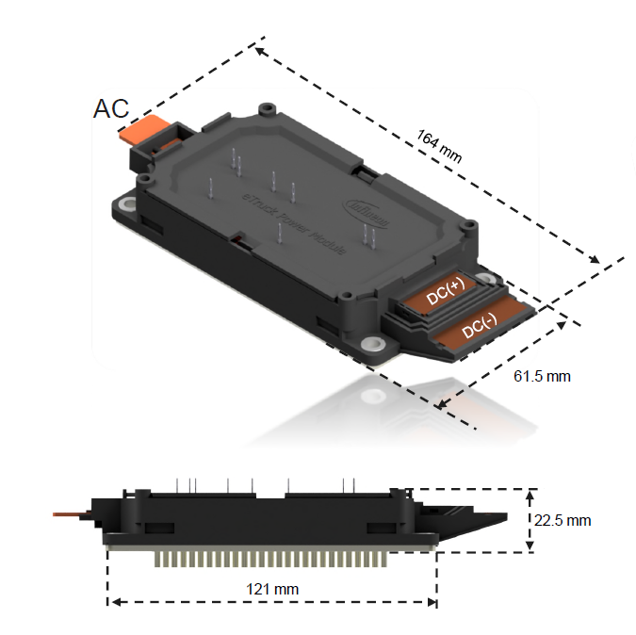
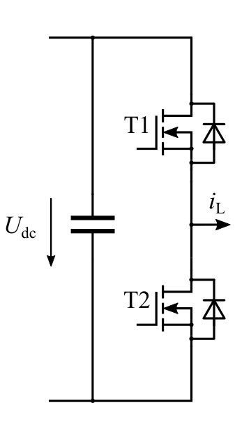
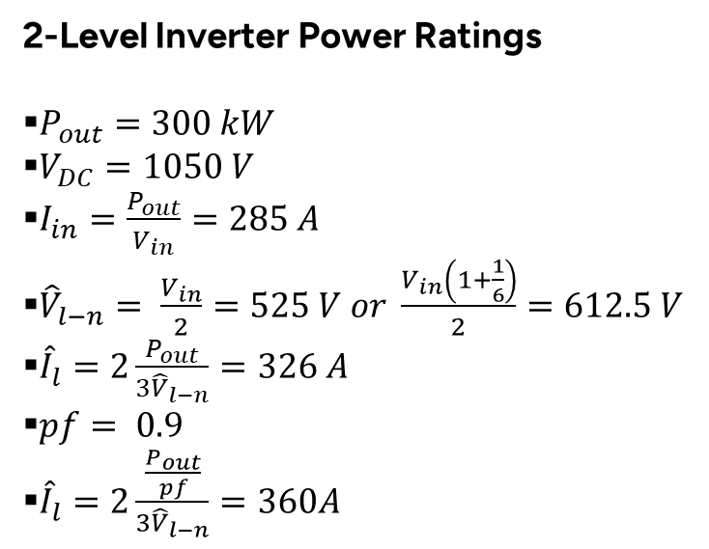
WP4.1 Inverter topology and construction
2-Level Inverter Power Ratings
$P_{out}=300 kW$
$V_{DC}=1050 V$
$I_{in}=\frac{P_{out}}{V_{in}}=285 A$
${\hat{V}}_{l−n}= \frac{V_{in}}{2}=525 V or \frac{V_{in}\left(1+\frac{1}{6}\right)}{2}=612.5 V$
${\hat{I}}_{l}=2\frac{P_{out}}{{3\hat{V}}_{l−n}}=326 A$
$pf= 0.9$
${\hat{I}}_{l}=2\frac{\frac{P_{out}}{pf}}{{3\hat{V}}_{l−n}}=360A$

Slide 3

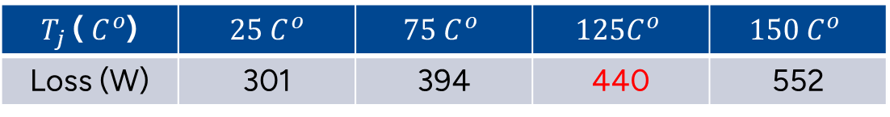
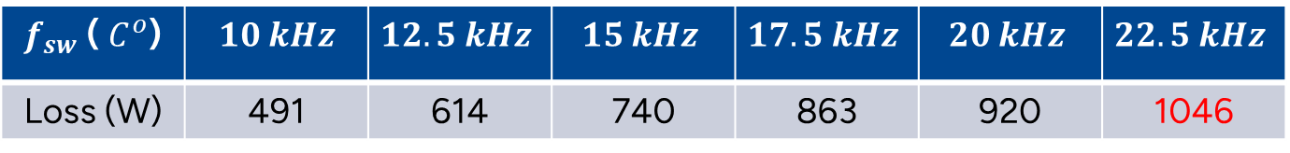

Datasheet-driven Loss Calculation
$$10 kHz$$
$$10 kHz$$
$T_{j}$ ( $C^{o}$) | $$25 C^{o}$$ | $$75 C^{o}$$ | $$125C^{o}$$ | $$150 C^{o}$$
Loss (W) | 301 | 394 | 440 | 552
Conduction Loss
$f_{sw}$ ( $C^{o}$) | $$10 kHz$$ | $$12.5 kHz$$ | $$15 kHz$$ | $$17.5 kHz$$ | $$20 kHz$$ | $$22.5 kHz$$
Loss (W) | 491 | 614 | 740 | 863 | 920 | 1046
Switching Loss

Slide 4
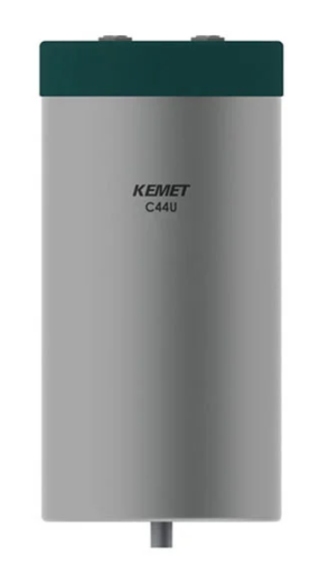


DC-link Capacitor Current Ripple
1070 V 415 A
KEMET C44U-T
$$>270 μF$$
2x $135 μF$

Slide 5
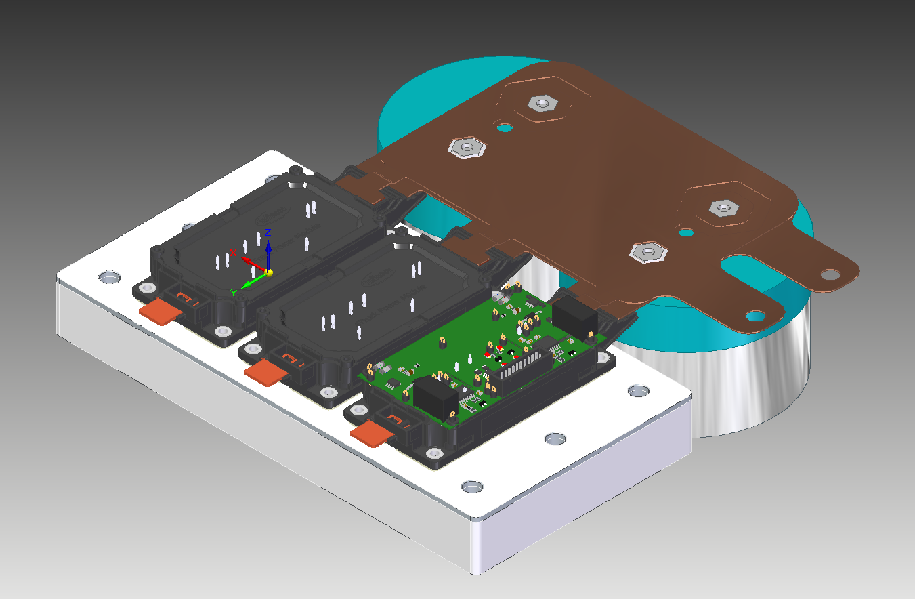
Inverter overall size
Part | Volume
Bottom_HEATSINK.par | 1128153.577 mm^3
busbar_newmos.par | 38129.616 mm^3
CACAITOR.par | 822118.411 mm^3
Mosfet.par | 143822.588 mm^3
TOP_HEATSINK.par | 83362.951 mm^3
Total sum | 4147469.139 mm^3
 | 4.14 litre
Power Density | ~72 kW/L
Box Power Density | ~50kW/L (Estimated)

Slide 6
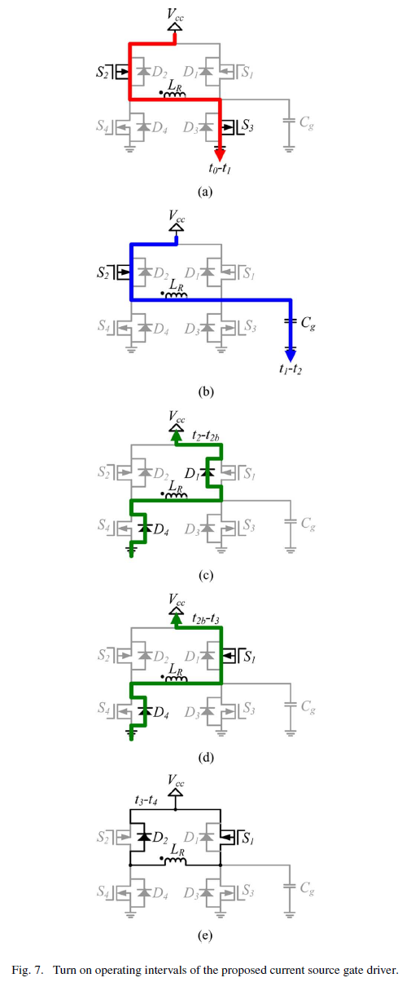
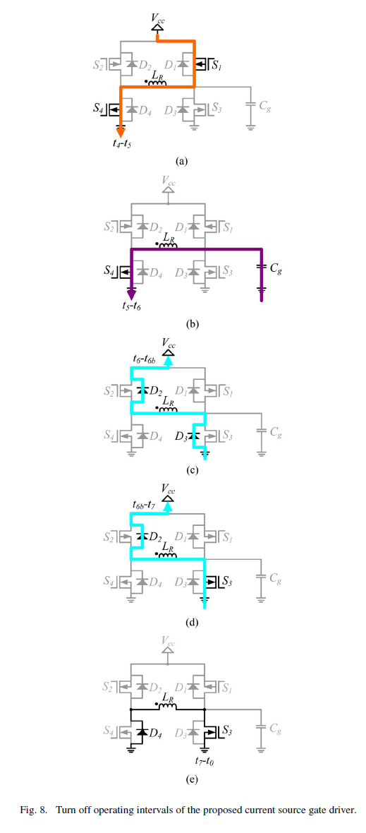
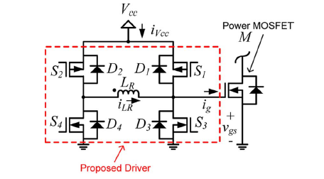
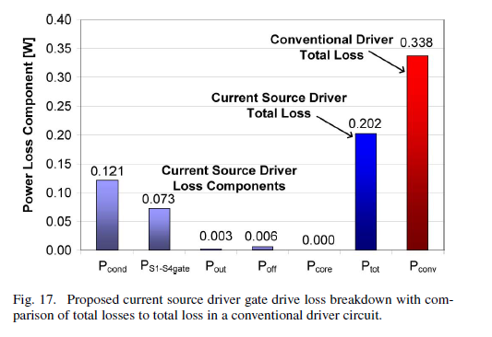
Gate Driver
WP4.3 Cooling of DC link capacitors

Slide 7
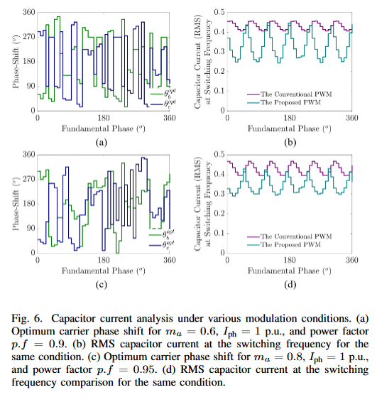
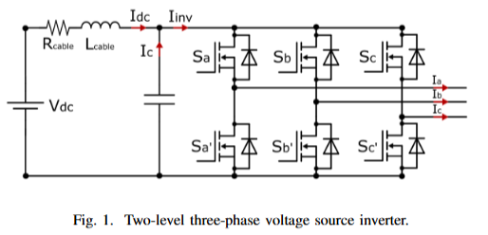
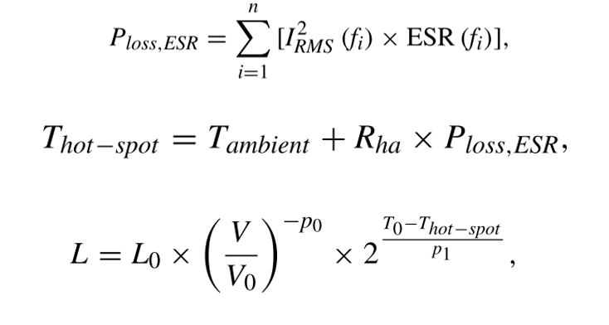
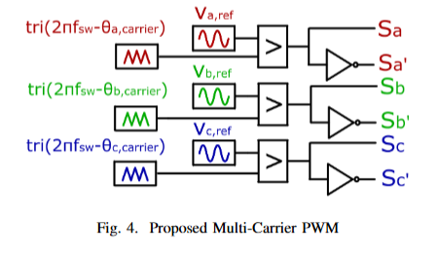

WP4.3 Cooling of DC link capacitors
DC-link Current Ripple Minimization : DC-link current harmonics influence thermal stress,
affecting capacitor lifespan.

Slide 8
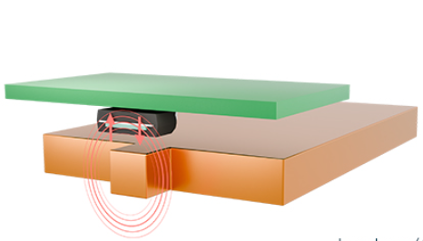
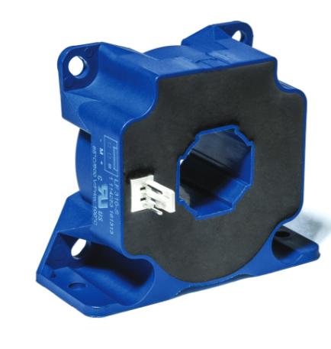
WP4.4 High-bandwidth Current Measurement
Feature | LEM LF 310-S | Melexis MLX91235
Type | Closed-loop Hall transducer (module) | Coreless Hall IC (external primary)
Bandwidth | ~100 kHz | ~500 kHz
Isolation | Built-in, robust | Needs system-level design
Integration | Plug-and-play module | PCB integration, calibration
Best use | Differential phase current sensing for inverter control | High-speed di/dt or ripple/harmonic measurement

